Slide 1
Suspended bed material load

Slide 2


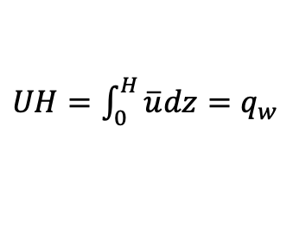
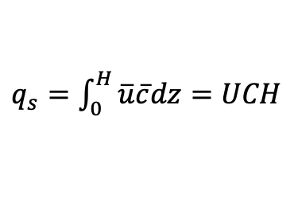
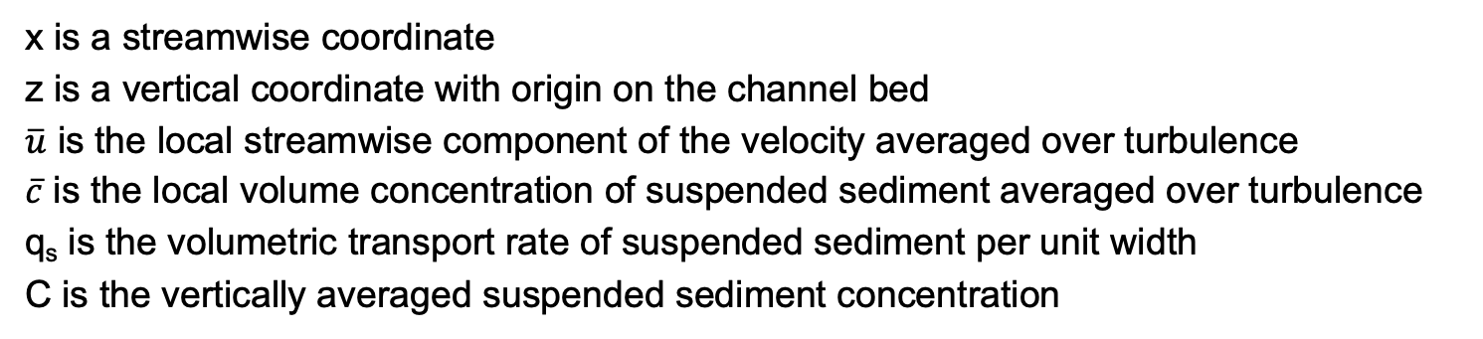
Definitions
flow
z
$$\overline{u}$$
H
$$\overline{c}$$
where
x
x is a streamwise coordinate
z is a vertical coordinate with origin on the channel bed
$\overline{u}$ is the local streamwise component of the velocity averaged over turbulence
$\overline{c}$ is the local volume concentration of suspended sediment averaged over turbulence
q_{s} is the volumetric transport rate of suspended sediment per unit width
C is the vertically averaged suspended sediment concentration
$UH=\int_{0}^{H}{\overline{u}dz}=q_{w}$
$q_{s}=\int_{0}^{H}{\overline{u}\overline{c}dz}=UCH$

Slide 3
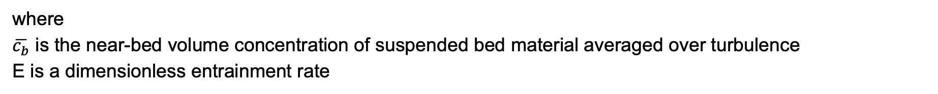
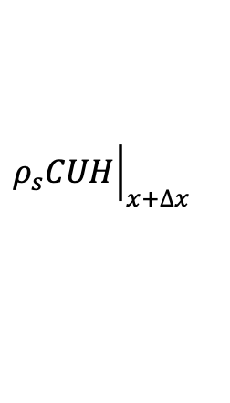

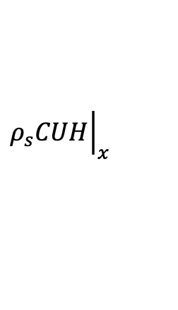



1D conservation of suspended bed material in the water column
The time rate of change of suspended sediment mass in a control volume is equal to the net mass inflow rate of suspended sediment, plus mass rate of sediment entrained from the bed minus the mass rate of sediment deposited on the bed.
$${\left.ρ_{s}CUH\right|}_{x}$$
$${\left.ρ_{s}CUH\right|}_{x+∆x}$$
flow
$${ρ_{s}E}_{s}Δx$$
$${ρ_{s}D}_{s}Δx$$
Δx
where
E_{s} is the volume rate per unit bed area of sediment entrained in suspension from the bed
D_{s} is the volume rate per unit bed area of sediment deposited from suspension on the bed
For the case of dilute suspension considered here
$$D_{s}=v_{s}\overline{c_{b}}$$
$$E_{s}=v_{s}E$$
where
$\overline{c_{b}}$ is the near-bed volume concentration of suspended bed material averaged over turbulence
E is a dimensionless entrainment rate

Slide 4
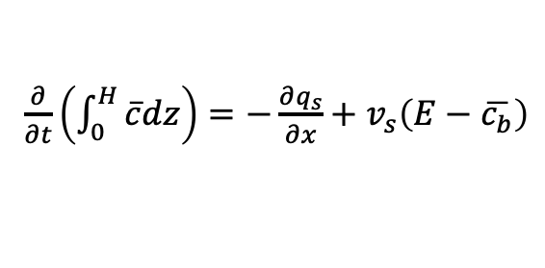
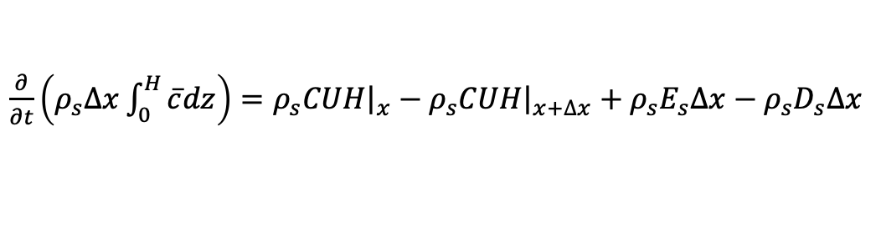

1D conservation of suspended bed material in the water column
The time rate of change of suspended sediment mass in a control volume is equal to the net mass inflow rate of suspended sediment, plus mass rate of sediment entrained from the bed minus the mass rate of sediment deposited on the bed.
$${\left.ρ_{s}CUH\right|}_{x}$$
$${\left.ρ_{s}CUH\right|}_{x+∆x}$$
flow
$${ρ_{s}E}_{s}Δx$$
$${ρ_{s}D}_{s}Δx$$
Δx
$\frac{∂}{∂t}\left(ρ_{s}∆x\int_{0}^{H}{\overline{c}dz}\right)={\left.ρ_{s}CUH\right|}_{x}−{\left.ρ_{s}CUH\right|}_{x+∆x}+{ρ_{s}E}_{s}Δx−{ρ_{s}D}_{s}Δx$
dividing both members by ρ_{s}Δx and reducing this equation with the relations for q_{s}, E_{s} and D_{s} it is found that
$\frac{∂}{∂t}\left(\int_{0}^{H}{\overline{c}dz}\right)=−\frac{∂q_{s}}{∂x}+v_{s}\left(E−\overline{c_{b}}\right)$
In most cases $\overline{c}≪1$ and the above equation becomes
$\frac{∂q_{s}}{∂x}=v_{s}\left(E−\overline{c_{b}}\right)$

Slide 5


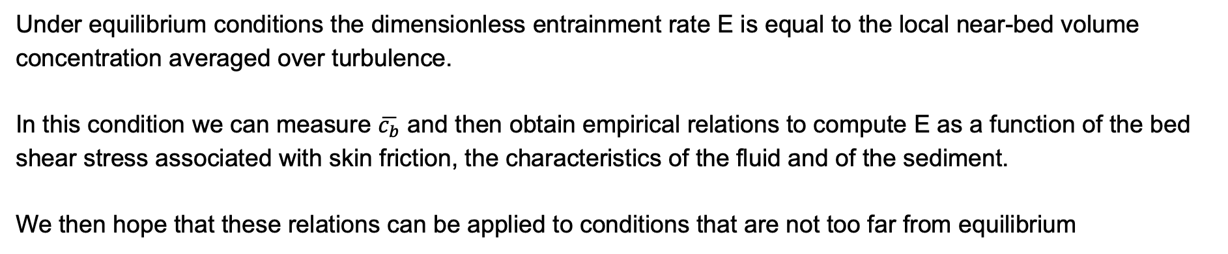
The approach
In the case of equilibrium suspension, the suspended bed material load does not change in the flow direction (x) and the equation of conservation of suspended bed material load reduces to
$v_{s}\left(E−\overline{c_{b}}\right)=0$
$$E=\overline{c_{b}}$$
Under equilibrium conditions the dimensionless entrainment rate E is equal to the local near-bed volume concentration averaged over turbulence.
In this condition we can measure $\overline{c_{b}}$ and then obtain empirical relations to compute E as a function of the bed shear stress associated with skin friction, the characteristics of the fluid and of the sediment.
We then hope that these relations can be applied to conditions that are not too far from equilibrium

Slide 6
The approach
In the case of equilibrium suspension, the suspended bed material load does not change in the flow direction (x) and the equation of conservation of suspended bed material load reduces to
$v_{s}\left(E−\overline{c_{b}}\right)=0$
$$E=\overline{c_{b}}$$
Under equilibrium conditions the dimensionless entrainment rate E is equal to the local near-bed volume concentration averaged over turbulence.
In this condition we can measure $\overline{c_{b}}$ and then obtain empirical relations to compute E as a function of the bed shear stress associated with skin friction, the characteristics of the fluid and of the sediment.
We then hope that these relations can be applied to conditions that are not too far from equilibrium
How close to the bed we need to measure $\overline{c_{b}}$?
we measure $\overline{c_{b}}$ at an elevation z = b such that b/H<<1 (different researchers pick different values of b)

Slide 7
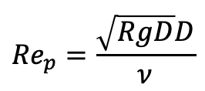


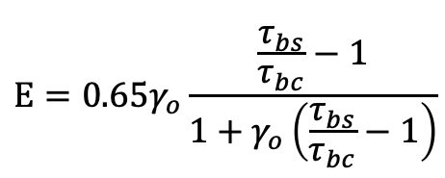
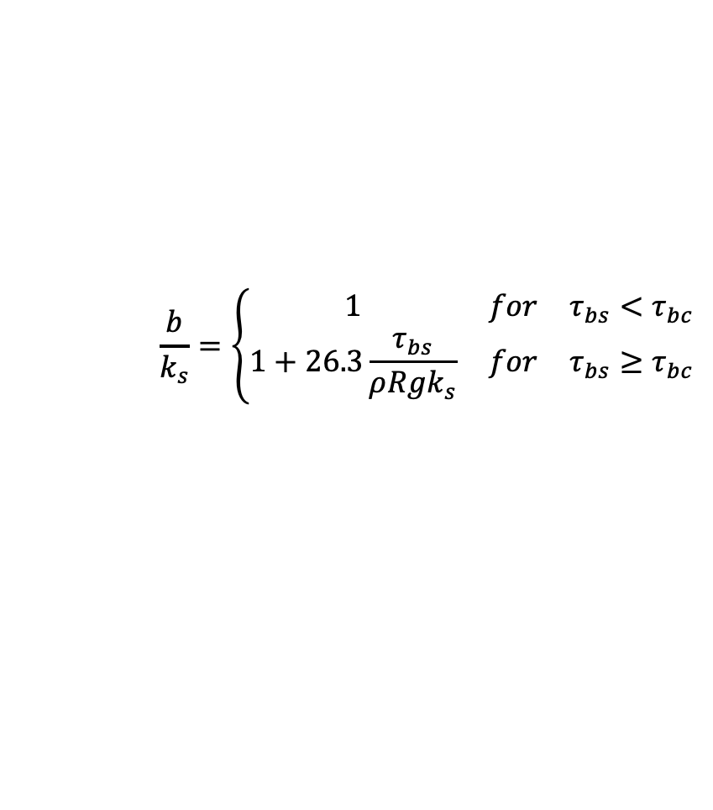
Smith and McLean entrainment relation for uniform material
$$E=0.65γ_{o}\frac{\frac{τ_{bs}}{τ_{bc}}−1}{1+γ_{o}\left(\frac{τ_{bs}}{τ_{bc}}−1\right)}$$
$γ_{o}=0.0024$
where
τ_{bs} is the bed shear stress associated with skin friction
τ_{bc} is the bed shear stress for the initiation of motion
The reference height z = b where $\overline{c}=\overline{c_{b}}$ is evaluated at what the authors describe as the top of the bedload layer as
$$\frac{b}{k_{s}}=\left\{\begin{matrix}1 & for & τ_{bs}<τ_{bc} \\ 1+26.3\frac{τ_{bs}}{ρRgk_{s}} & for & τ_{bs}≥τ_{bc}\end{matrix}\right.$$
where k_{s} is the grain roughness height
Parker (2004) suggests to compute τ_{bc} with the Brownlie (1981) relation for the Shields curve as $ρRgDτ_{c}^{∗}$
$${Re}_{p}=\frac{\sqrt{RgD}D}{ν}$$
$$τ_{c}^{∗}=0.22{Re}_{p}^{−0.6}+0.06∙{10}^{−7.7{Re}_{p}^{−0.6}}$$

Slide 8
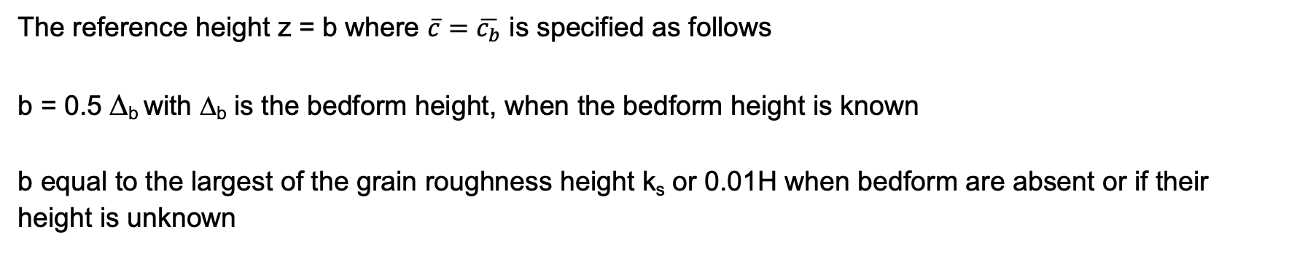
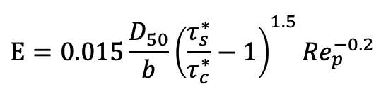
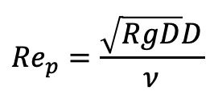

Van Rijn entrainment relation for uniform material
$$E=0.015\frac{D_{50}}{b}{\left(\frac{τ_{s}^{∗}}{τ_{c}^{∗}}−1\right)}^{1.5}{Re}_{p}^{−0.2}$$
$${Re}_{p}=\frac{\sqrt{RgD}D}{ν}$$
The reference height z = b where $\overline{c}=\overline{c_{b}}$ is specified as follows
b = 0.5 Δ_{b} with Δ_{b} is the bedform height, when the bedform height is known
b equal to the largest of the grain roughness height k_{s} or 0.01H when bedform are absent or if their height is unknown
The critical Shields number can be estimated with the Brownlie fit as
$$τ_{c}^{∗}=0.22{Re}_{p}^{−0.6}+0.06∙{10}^{−7.7{Re}_{p}^{−0.6}}$$

Slide 9
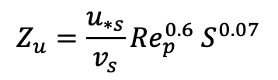
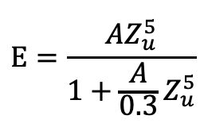
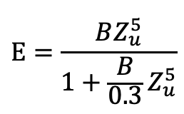
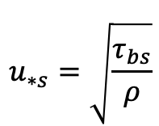
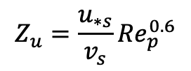
Garcia and Parker entrainment relation for uniform material
$$E=\frac{AZ_{u}^{5}}{1+\frac{A}{0.3}Z_{u}^{5}}$$
$$u_{∗s}=\sqrt{\frac{τ_{bs}}{ρ}}$$
$$Z_{u}=\frac{u_{∗s}}{v_{s}}{Re}_{p}^{0.6}$$
where $A=1.3∙{10}^{−7}$ and the reference height z = b where $\overline{c}=\overline{c_{b}}$ is equal to 0.05H
Wright and Parker entrainment relation for uniform material
Wright and Parker found that the relation by Garcia and Parker works well in the laboratory and in small and medium sand bed rivers. It does not perform well in large, low slope sand bed rivers. They thus proposed a modified version of the Garcia and Parker entrainment relation to cover spatial scales ranging from the lab to large, low-slope rivers.
$$E=\frac{BZ_{u}^{5}}{1+\frac{B}{0.3}Z_{u}^{5}}$$
$$Z_{u}=\frac{u_{∗s}}{v_{s}}{Re}_{p}^{0.6}{ S}^{0.07}$$
where $B=7.8∙{10}^{−7}$ and the reference height z = b where $\overline{c}=\overline{c_{b}}$ is equal to 0.05H

Slide 10

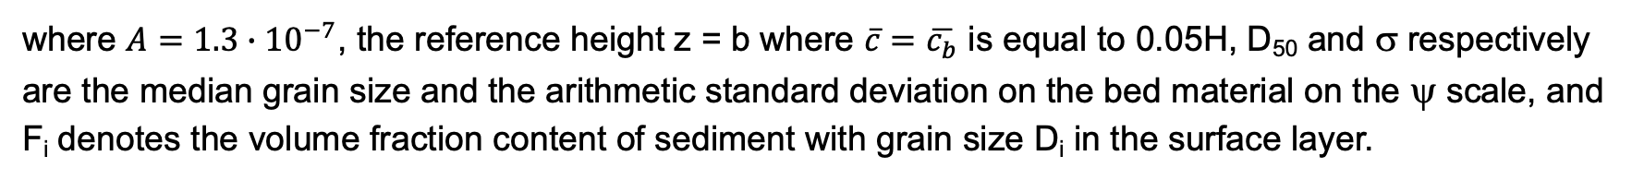
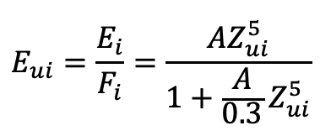
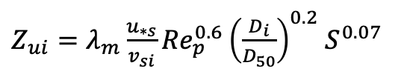
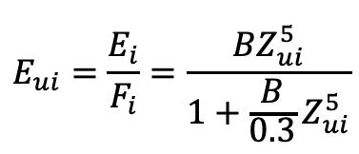
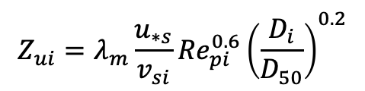
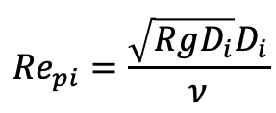
Garcia and Parker entrainment relation for mix-size material
$$E_{ui}=\frac{E_{i}}{F_{i}}=\frac{AZ_{ui}^{5}}{1+\frac{A}{0.3}Z_{ui}^{5}}$$
$$Z_{ui}=λ_{m}\frac{u_{∗s}}{v_{si}}{Re}_{pi}^{0.6}{\left(\frac{D_{i}}{D_{50}}\right)}^{0.2}$$
$${Re}_{pi}=\frac{\sqrt{RgD_{i}}D_{i}}{ν}$$
$$λ_{m}=1−0.298σ$$
where $A=1.3∙{10}^{−7}$, the reference height z = b where $\overline{c}=\overline{c_{b}}$ is equal to 0.05H, D₅₀ and σ respectively are the median grain size and the arithmetic standard deviation on the bed material on the ψ scale, and F_{i} denotes the volume fraction content of sediment with grain size D_{i} in the surface layer.
Wright and Parker entrainment relation for mix-size material
Wright and Parker modified the Garcia and Parker formulation so that it can also be applied to large, low-slope sand bed rivers.
$$E_{ui}=\frac{E_{i}}{F_{i}}=\frac{BZ_{ui}^{5}}{1+\frac{B}{0.3}Z_{ui}^{5}}$$
$Z_{ui}=λ_{m}\frac{u_{∗s}}{v_{si}}{Re}_{p}^{0.6}{\left(\frac{D_{i}}{D_{50}}\right)}^{0.2}{ S}^{0.07}$
where $B=7.8∙{10}^{−7}$ and the reference height z = b where $\overline{c}=\overline{c_{b}}$ is equal to 0.05H

Slide 11
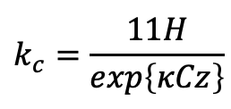
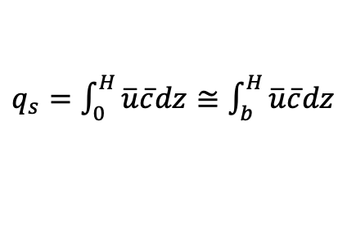
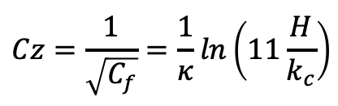
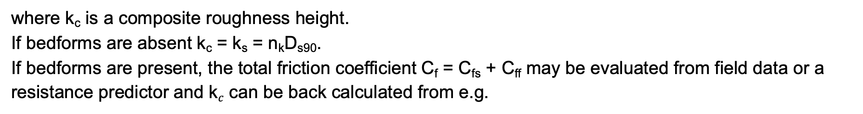

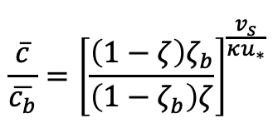
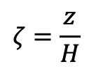
Calculation of 1D suspended sediment transport rate
The volume suspended sediment transport rate per unit channel width q_{s} is computed as
$$\frac{\overline{c}}{\overline{c_{b}}}={\left[\frac{\left(1−ζ\right)ζ_{b}}{\left(1−ζ_{b}\right)ζ}\right]}^{\frac{v_{s}}{κu_{∗}}}$$
$q_{s}=\int_{0}^{H}{\overline{u}\overline{c}dz}≅\int_{b}^{H}{\overline{u}\overline{c}dz}$
$$ζ=\frac{z}{H}$$
where
and
$\overline{u}=\frac{u_{∗}}{κ}ln\left(30\frac{z}{k_{c}}\right)$
where k_{c} is a composite roughness height.
If bedforms are absent k_{c} = k_{s} = n_{k}D_{s90}.
If bedforms are present, the total friction coefficient C_{f} = C_{fs} + C_{ff} may be evaluated from field data or a resistance predictor and k$c$ can be back calculated from e.g.
$$Cz=\frac{1}{\sqrt{C_{f}}}=\frac{1}{κ}ln\left(11\frac{H}{k_{c}}\right)$$
$$k_{c}=\frac{11H}{exp\left\{κCz\right\}}$$

Slide 12

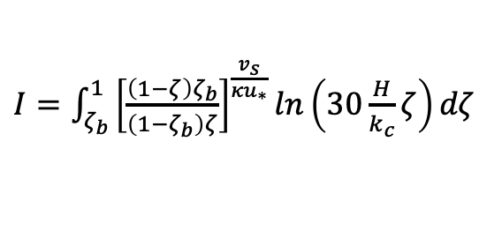
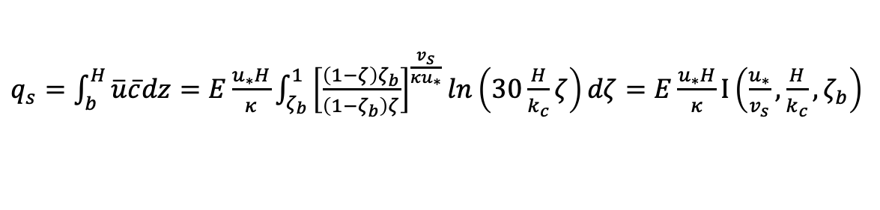
Calculation of suspended sediment transport rate
Recalling that ζ = z/H, the volume suspended sediment transport rate per unit channel width q_{s} for the case of equilibrium suspension ($\overline{c_{b}}=E$) is computed as
$q_{s}=\int_{b}^{H}{\overline{u}\overline{c}dz}=E\frac{u_{∗}H}{κ}\int_{ζ_{b}}^{1}{{\left[\frac{\left(1−ζ\right)ζ_{b}}{\left(1−ζ_{b}\right)ζ}\right]}^{\frac{v_{s}}{κu_{∗}}}ln\left(30\frac{H}{k_{c}}ζ\right)dζ}=E\frac{u_{∗}H}{κ}I\left(\frac{u_{∗}}{v_{s}},\frac{H}{k_{c}},ζ_{b}\right)$
where
$I=\int_{ζ_{b}}^{1}{{\left[\frac{\left(1−ζ\right)ζ_{b}}{\left(1−ζ_{b}\right)ζ}\right]}^{\frac{v_{s}}{κu_{∗}}}ln\left(30\frac{H}{k_{c}}ζ\right)dζ}$
In this formulation the reference level z = b (ζ = ζ_{b}) cannot be set equal to 0 because turbulence cannot persist all the way down to a solid boundary or a granular bed.
For this reason, the logarithmic velocity profile predicts infinite negative velocity at z = 0.
$\overline{u}=\frac{u_{∗}}{κ}ln\left(30\frac{z}{k_{c}}\right)$
The point of vanishing velocity is at z = k_{c}/30.
In our analysis the eddy diffusivity was derived from the log law, thus, $\overline{c}$ cannot be computed all the way down to z = 0. The near bed boundary condition should be specified at z = b >= k_{c}/30

Slide 13
Calculations of the total bed material load on the Congaree River in the Congaree National Park, SC
Given:
The flow duration curve, a site-specific suspended bed material load equation, an estimate of the bankfull discharge, channel slope, floodplain width, bankfull width and bankfull depth, grain size distribution of the bed surface sand and floodplain friction coeffcient (excel file CongareeRiver_data.xlsx)
estimate the flow intermittency assuming that the sediment is uniform and that the intermittency based on suspended load is the same as the intermittency for total load and bedload
Compare the bed material transport capacity at bankfull flow estimated with the Naito et al total load relation for mixtures, with the sum of bedload and suspended load transport capacities respectively computed with the Ashida and Michiue and the Garcia and Parker models.
In the calculation, divide the A coefficient of the Naito model by 100 to account for the fact that the Congaree River is a sand bed river with a transport capacity that is two orders of magnitude smaller than the transport capacity of the fine sand/silt-bed Yellow River used to derive model parameters.

Slide 14
What happens in the water column?

Slide 15
Local equation of conservation of suspended sediment
(x+Δx, y+Δy, z+Δz)
When entrained in transport, suspended sediment is transported by turbulent flow.
NOTATION
c instantaneous volumetric suspended sediment concentration
(u, v, w) instantaneous flow velocity vector
(u, v, w-v_{s}) instantaneous velocity of a suspended particle, with v_{s} being the particle settling velocity in still water.
z
(x, y, z)
y
x

Slide 16
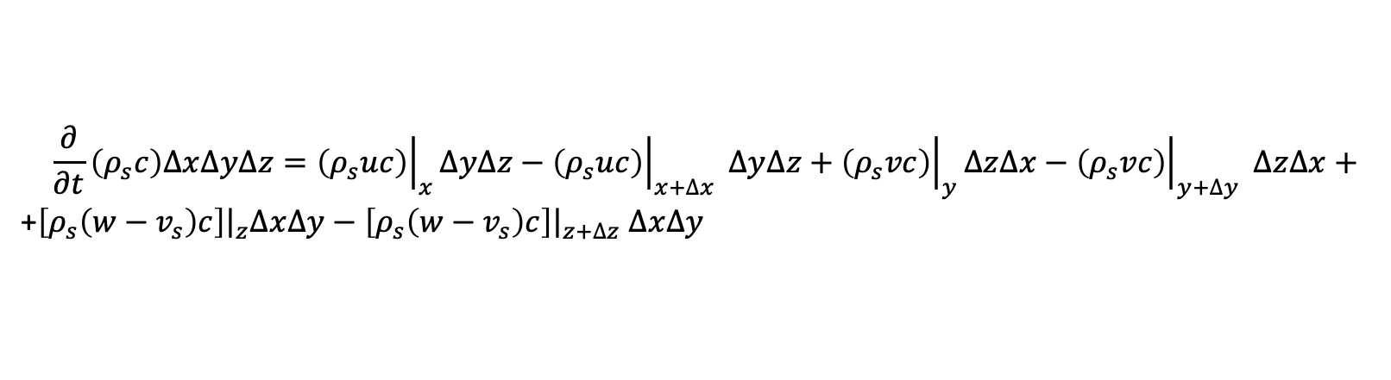
Local equation of conservation of suspended sediment
(x+Δx, y+Δy, z+Δz)
When entrained in transport, suspended sediment is transported by turbulent flow.
NOTATION
c instantaneous volumetric suspended sediment concentration
(u, v, w) instantaneous flow velocity vector
(u, v, w-v_{s}) instantaneous velocity of a suspended particle, with v_{s} being the particle settling velocity in still water.
z
(x, y, z)
y
MASS BALANCE
The time rate of change of sediment mass in the control volume is equal to the net mass influx rate of sediment in the control volume.
x
$$\frac{∂}{∂t}\left(ρ_{s}c\right)∆x∆y∆z={\left.\left(ρ_{s}uc\right)\right|}_{x}∆y∆z−{\left.\left(ρ_{s}uc\right)\right|}_{x+∆x} ∆y∆z+{\left.\left(ρ_{s}vc\right)\right|}_{y}∆z∆x−{\left.\left(ρ_{s}vc\right)\right|}_{y+∆y} ∆z∆x+$$
+${\left.\left[ρ_{s}\left(w−v_{s}\right)c\right]\right|}_{z}∆x∆y−{\left.\left[ρ_{s}\left(w−v_{s}\right)c\right]\right|}_{z+∆z} ∆x∆y$

Slide 17
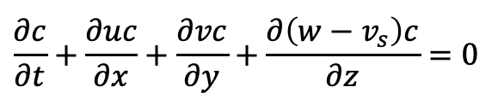
Local equation of conservation of suspended sediment
(x+Δx, y+Δy, z+Δz)
Dividing the mass balance equation on slide 13 by ρ_{s}ΔxΔyΔz, it is found that
z
$$\frac{∂c}{∂t}+\frac{∂uc}{∂x}+\frac{∂vc}{∂y}+\frac{∂\left(w−v_{s}\right)c}{∂z}=0$$
(x, y, z)
y
x

Slide 18




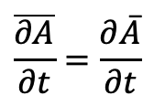




Local equation of conservation of suspended sediment averaged over turbulence
u
Dividing the mass balance equation on slide 13 by ρ_{s}ΔxΔyΔz, it is found that
$$u′$$
$$\frac{∂c}{∂t}+\frac{∂uc}{∂x}+\frac{∂vc}{∂y}+\frac{∂\left(w−v_{s}\right)c}{∂z}=0$$
$$\overline{u}$$
time
In a turbulent flow c, u, v and w fluctuate in space and time around values that can be considered constant at time scales that are long compared with those of the fluctuations. c, u, v and w can be then rewritten as
$$c=\overline{c}+c′$$
$$u=\overline{u}+u′$$
$$v=\overline{v}+v′$$
$$w=\overline{w}+w′$$
with
$$\overline{c′}=\overline{u′}=\overline{v′}=\overline{w′}=0$$
In addition
and
$$\overline{\frac{∂A}{∂t}}=\frac{∂\overline{A}}{∂t}$$
$$\overline{A+B}=\overline{A}+\overline{B}$$

Slide 19
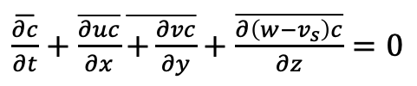
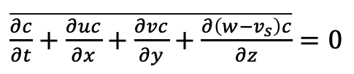
Local equation of conservation of suspended sediment averaged over turbulence
The local equation of conservation of suspended sediment averaged over turbulence takes the form
$\overline{\frac{∂c}{∂t}+\frac{∂uc}{∂x}+\frac{∂vc}{∂y}+\frac{∂\left(w−v_{s}\right)c}{∂z}}=0$
$\overline{\frac{∂c}{∂t}}+\overline{\frac{∂uc}{∂x}}\overline{+\frac{∂vc}{∂y}}+\overline{\frac{∂\left(w−v_{s}\right)c}{∂z}}=0$

Slide 20
Local equation of conservation of suspended sediment averaged over turbulence
The local equation of conservation of suspended sediment averaged over turbulence takes the form
$\overline{\frac{∂c}{∂t}+\frac{∂uc}{∂x}+\frac{∂vc}{∂y}+\frac{∂\left(w−v_{s}\right)c}{∂z}}=0$
$\overline{\frac{∂c}{∂t}}+\overline{\frac{∂uc}{∂x}}\overline{+\frac{∂vc}{∂y}}+\overline{\frac{∂\left(w−v_{s}\right)c}{∂z}}=0$
$\frac{∂\overline{\left(\overline{c}+c^{′}\right)}}{∂t}+\frac{∂\overline{\left(\overline{u}+u^{′}\right)\left(\overline{c}+c^{′}\right)}}{∂x}+\frac{∂\overline{\left(\overline{v}+v^{′}\right)\left(\overline{c}+c^{′}\right)}}{∂y}+\frac{∂\overline{\left(\overline{w}+w^{′}−v_{s}\right)\left(\overline{c}+c^{′}\right)}}{∂z}=0$

Slide 21

Local equation of conservation of suspended sediment averaged over turbulence
The local equation of conservation of suspended sediment averaged over turbulence takes the form
$\overline{\frac{∂c}{∂t}+\frac{∂uc}{∂x}+\frac{∂vc}{∂y}+\frac{∂\left(w−v_{s}\right)c}{∂z}}=0$
$\overline{\frac{∂c}{∂t}}+\overline{\frac{∂uc}{∂x}}\overline{+\frac{∂vc}{∂y}}+\overline{\frac{∂\left(w−v_{s}\right)c}{∂z}}=0$
$\frac{∂\overline{\left(\overline{c}+c^{′}\right)}}{∂t}+\frac{∂\overline{\left(\overline{u}+u^{′}\right)\left(\overline{c}+c^{′}\right)}}{∂x}+\frac{∂\overline{\left(\overline{v}+v^{′}\right)\left(\overline{c}+c^{′}\right)}}{∂y}+\frac{∂\overline{\left(\overline{w}+w^{′}+v_{s}\right)\left(\overline{c}+c^{′}\right)}}{∂z}=0$
The average of the products between a velocity component and the concentration is computed as follows
$$\overline{\left(\overline{u}+u^{′}\right)\left(\overline{c}+c^{′}\right)}=\overline{\overline{u}\overline{c}+\overline{u}c^{′}+u^{′}\overline{c}+u^{′}c^{′}}=\overline{u}\overline{c}+\overline{u^{′}c^{′}}$$

Slide 22
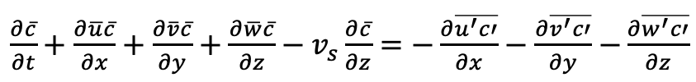
Local equation of conservation of suspended sediment averaged over turbulence
The local equation of conservation of suspended sediment averaged over turbulence takes the form
$\overline{\frac{∂c}{∂t}+\frac{∂uc}{∂x}+\frac{∂vc}{∂y}+\frac{∂\left(w−v_{s}\right)c}{∂z}}=0$
$\overline{\frac{∂c}{∂t}}+\overline{\frac{∂uc}{∂x}}\overline{+\frac{∂vc}{∂y}}+\overline{\frac{∂\left(w−v_{s}\right)c}{∂z}}=0$
$\frac{∂\overline{\left(\overline{c}+c^{′}\right)}}{∂t}+\frac{∂\overline{\left(\overline{u}+u^{′}\right)\left(\overline{c}+c^{′}\right)}}{∂x}+\frac{∂\overline{\left(\overline{v}+v^{′}\right)\left(\overline{c}+c^{′}\right)}}{∂y}+\frac{∂\overline{\left(\overline{w}+w^{′}+v_{s}\right)\left(\overline{c}+c^{′}\right)}}{∂z}=0$
The average of the products between a velocity component and the concentration is computed as follows
$$\overline{\left(\overline{u}+u^{′}\right)\left(\overline{c}+c^{′}\right)}=\overline{\overline{u}\overline{c}+\overline{u}c^{′}+u^{′}\overline{c}+u^{′}c^{′}}=\overline{u}\overline{c}+\overline{u^{′}c^{′}}$$
Substituting in the averaged equation it is found that
$\frac{∂\overline{c}}{∂t}+\frac{∂\overline{u}\overline{c}}{∂x}+\frac{∂\overline{v}\overline{c}}{∂y}+\frac{∂\overline{w}\overline{c}}{∂z}−v_{s}\frac{∂\overline{c}}{∂z}=−\frac{∂\overline{u^{′}c′}}{∂x}−\frac{∂\overline{v^{′}c′}}{∂y}$ $−\frac{∂\overline{w^{′}c′}}{∂z}$

Slide 23
Local equation of conservation of suspended sediment averaged over turbulence
The local equation of conservation of suspended sediment averaged over turbulence takes the form
$\overline{\frac{∂c}{∂t}+\frac{∂uc}{∂x}+\frac{∂vc}{∂y}+\frac{∂\left(w−v_{s}\right)c}{∂z}}=0$
$\overline{\frac{∂c}{∂t}}+\overline{\frac{∂uc}{∂x}}\overline{+\frac{∂vc}{∂y}}+\overline{\frac{∂\left(w−v_{s}\right)c}{∂z}}=0$
$\frac{∂\overline{\left(\overline{c}+c^{′}\right)}}{∂t}+\frac{∂\overline{\left(\overline{u}+u^{′}\right)\left(\overline{c}+c^{′}\right)}}{∂x}+\frac{∂\overline{\left(\overline{v}+v^{′}\right)\left(\overline{c}+c^{′}\right)}}{∂y}+\frac{∂\overline{\left(\overline{w}+w^{′}+v_{s}\right)\left(\overline{c}+c^{′}\right)}}{∂z}=0$
The average of the products between a velocity component and the concentration is computed as follows
$$\overline{\left(\overline{u}+u^{′}\right)\left(\overline{c}+c^{′}\right)}=\overline{\overline{u}\overline{c}+\overline{u}c^{′}+u^{′}\overline{c}+u^{′}c^{′}}=\overline{u}\overline{c}+\overline{u^{′}c^{′}}$$
Substituting in the averaged equation it is found that
$\frac{∂\overline{c}}{∂t}+\frac{∂\overline{u}\overline{c}}{∂x}+\frac{∂\overline{v}\overline{c}}{∂y}+\frac{∂\overline{w}\overline{c}}{∂z}−v_{s}\frac{∂\overline{c}}{∂z}=−\frac{∂\overline{u^{′}c′}}{∂x}−\frac{∂\overline{v^{′}c′}}{∂y}$ $−\frac{∂\overline{w^{′}c′}}{∂z}$
how do we deal with those?

Slide 24
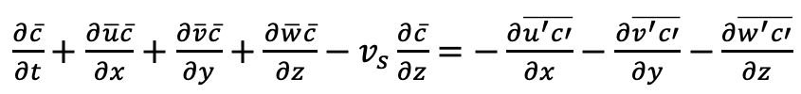



Reynolds flux of suspended sediment
$\frac{∂\overline{c}}{∂t}+\frac{∂\overline{u}\overline{c}}{∂x}+\frac{∂\overline{v}\overline{c}}{∂y}+\frac{∂\overline{w}\overline{c}}{∂z}−v_{s}\frac{∂\overline{c}}{∂z}=−\frac{∂\overline{u^{′}c′}}{∂x}−\frac{∂\overline{v^{′}c′}}{∂y}$ $−\frac{∂\overline{w^{′}c′}}{∂z}$
The quantities $\overline{u^{′}c^{′}}$, $\overline{v^{′}c^{′}}$ and $\overline{w^{′}c^{′}}$ denote the convective Reynolds fluxes of suspended sediment. They characterize the tendency of turbulence to mix suspended sediment from areas of high concentrations to areas of low concentration, i.e. down the gradient of mean concentration.
flow
z
$$\overline{u}$$
H
$$\overline{c}$$
$$c^{′}>0, w^{′}>0,{ w}^{′}c′>0$$
In the figure above concentration declines in the positive z direction, turbulence mixes sediment from zones of high concentration (lower part of the water column) to zones of low concentration (higher part of the water column). This generates a positive value of $\overline{w^{′}c^{′}}$.

Slide 25

Reynolds flux of suspended sediment
$\frac{∂\overline{c}}{∂t}+\frac{∂\overline{u}\overline{c}}{∂x}+\frac{∂\overline{v}\overline{c}}{∂y}+\frac{∂\overline{w}\overline{c}}{∂z}−v_{s}\frac{∂\overline{c}}{∂z}=−\frac{∂\overline{u^{′}c′}}{∂x}−\frac{∂\overline{v^{′}c′}}{∂y}$ $−\frac{∂\overline{w^{′}c′}}{∂z}$
The quantities $\overline{u^{′}c^{′}}$, $\overline{v^{′}c^{′}}$ and $\overline{w^{′}c^{′}}$ denote the convective Reynolds fluxes of suspended sediment. They characterize the tendency of turbulence to mix suspended sediment from areas of high concentrations to areas of low concentration, i.e. down the gradient of mean concentration.
flow
z
$$\overline{u}$$
H
$$\overline{c}$$
$$c^{′}<0, w^{′}<0,w^{′}c′>0$$
In the figure above concentration declines in the positive z direction, turbulence mixes sediment from zones of high concentration (lower part of the water column) to zones of low concentration (higher part of the water column). This generates a positive value of $\overline{w^{′}c^{′}}$.

Slide 26
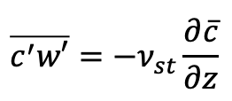
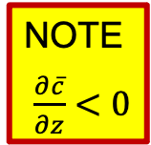
Reynolds flux of suspended sediment
$\frac{∂\overline{c}}{∂t}+\frac{∂\overline{u}\overline{c}}{∂x}+\frac{∂\overline{v}\overline{c}}{∂y}+\frac{∂\overline{w}\overline{c}}{∂z}−v_{s}\frac{∂\overline{c}}{∂z}=−\frac{∂\overline{u^{′}c′}}{∂x}−\frac{∂\overline{v^{′}c′}}{∂y}$ $−\frac{∂\overline{w^{′}c′}}{∂z}$
The quantities $\overline{u^{′}c^{′}}$, $\overline{v^{′}c^{′}}$ and $\overline{w^{′}c^{′}}$ denote the convective Reynolds fluxes of suspended sediment. They characterize the tendency of turbulence to mix suspended sediment from areas of high concentrations to areas of low concentration, i.e. down the gradient of mean concentration.
flow
z
$$\overline{u}$$
H
$$\overline{c}$$
$$c^{′}<0, w^{′}<0,w^{′}c′>0$$
The Reynolds flux of suspended sediment in the z direction can be modeled in terms of a kinematic eddy diffusivity as
$$\overline{c^{′}w′}=−ν_{st}\frac{∂\overline{c}}{∂z}$$
with ν_{st} being the kinematic eddy diffusivity of suspended sediment.
NOTE
$\frac{∂\overline{c}}{∂z}<0$

Slide 27
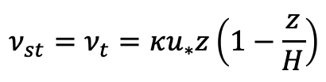



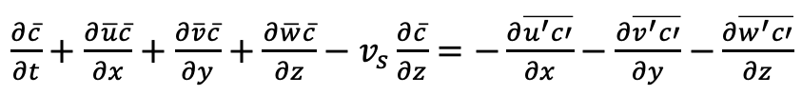
Equilibrium vertical distribution of suspended sediment
Turbulence transfers any quantity (momentum, heat, sediment mass) in the same fundamental way (Reynolds analogy).
The Reynolds analogy is an approximation that is good over a wide range of conditions and will help us understand how sediment is transported in the water column of open channels.
Consequence of the Reynolds analogy relevant to our problem is that the kinematic eddy diffusivity of suspended sediment ν_{st} is equal to the eddy viscosity ν_{t}. Thus, in the case of open channel flow
$$ν_{st}=ν_{t}=κu_{∗}z\left(1−\frac{z}{H}\right)$$
In the case of steady and uniform open channel flow, the local equation of conservation of suspended sediment mass averaged over turbulence reduces to
$\frac{∂\overline{c}}{∂t}+\frac{∂\overline{u}\overline{c}}{∂x}+\frac{∂\overline{v}\overline{c}}{∂y}+\frac{∂\overline{w}\overline{c}}{∂z}−v_{s}\frac{∂\overline{c}}{∂z}=−\frac{∂\overline{u^{′}c′}}{∂x}−\frac{∂\overline{v^{′}c′}}{∂y}$ $−\frac{∂\overline{w^{′}c′}}{∂z}$
$v_{s}\frac{d\overline{c}}{dz}−\frac{d\overline{w^{′}c^{′}}}{dz}=0$
or
$v_{s}\frac{d\overline{c}}{dz}−\frac{dF}{dz}=0$
where $F=\overline{w^{′}c^{′}}$

Slide 28

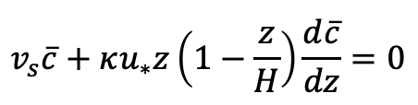
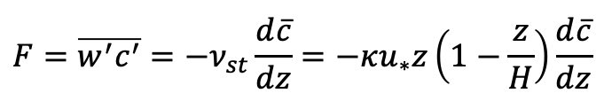

Equilibrium vertical distribution of suspended sediment
The local equation of conservation of suspended sediment mass averaged over turbulence for steady and uniform open channel flow is integrated with the boundary condition of zero sediment flux in the vertical (z) direction at the water surface
$v_{s}\frac{d\overline{c}}{dz}−\frac{dF}{dz}=0$
$$v_{s}\overline{c}−F=0$$
the upward flux of suspended sediment driven by turbulence (F) is perfectly balanced by the downward flux of suspended sediment associated with the particle settling velocity.
Recalling that
$$F=\overline{w^{′}c^{′}}=−ν_{st}\frac{d\overline{c}}{dz}=−κu_{∗}z\left(1−\frac{z}{H}\right)\frac{d\overline{c}}{dz}$$
The balance equation takes the form
$$v_{s}\overline{c}+κu_{∗}z\left(1−\frac{z}{H}\right)\frac{d\overline{c}}{dz}=0$$

Slide 29
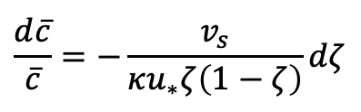
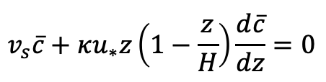

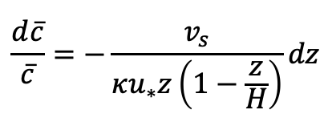

Equilibrium vertical distribution of suspended sediment
The balance equation between the upward sediment flux driven by turbulence and the downward flux associated with the particle settling velocity is
$$v_{s}\overline{c}+κu_{∗}z\left(1−\frac{z}{H}\right)\frac{d\overline{c}}{dz}=0$$
Rearranging the terms
$$\frac{d\overline{c}}{dz}+\frac{v_{s}}{κu_{∗}z\left(1−\frac{z}{H}\right)}\overline{c}=0$$
The above equation is integrated with the boundary condition of near-bed (z = b) suspended sediment concentration averaged over turbulence equal to $\overline{c_{b}}$
$$\frac{d\overline{c}}{\overline{c}}=−\frac{v_{s}}{κu_{∗}z\left(1−\frac{z}{H}\right)}dz$$
$$\frac{d\overline{c}}{\overline{c}}=−\frac{v_{s}}{κu_{∗}ζ\left(1−ζ\right)}dζ$$
recalling that $ζ=z/H$ it is found that

Slide 30







Equilibrium vertical distribution of suspended sediment
$$\frac{d\overline{c}}{\overline{c}}=−\frac{v_{s}}{κu_{∗}ζ\left(1−ζ\right)}dζ$$
Is integrated and it is found that
$$\ln\left(\overline{c}\right)=−\frac{v_{s}}{κu_{∗}}\left[ln\left(ζ\right)−ln\left(1−ζ\right)\right]+constant=ln\left[{\left(\frac{ζ}{1−ζ}\right)}^{−\frac{v_{s}}{κu_{∗}}}\right]+constant=ln\left[{\left(\frac{1−ζ}{ζ}\right)}^{\frac{v_{s}}{κu_{∗}}}\right]+constant$$
the above equation is rewritten as
$\overline{c}=C_{1}{\left(\frac{1−ζ}{ζ}\right)}^{\frac{v_{s}}{κu_{∗}}}$
the constant C₁ is determined with the boundary condition $\overline{c}=\overline{c_{b}}$ for z = b (or ζ = ζ_{b})
$\overline{c_{b}}=C_{1}{\left(\frac{1−ζ_{b}}{ζ_{b}}\right)}^{\frac{v_{s}}{κu_{∗}}}$
$C_{1}=\frac{\overline{c_{b}}}{{\left(\frac{1−ζ_{b}}{ζ_{b}}\right)}^{\frac{v_{s}}{κu_{∗}}}}$
and
the substituting C1 in the equation expressing the equilibrium vertical distribution of suspended sediment, the Rouse profile is derived
$$\frac{\overline{c}}{\overline{c_{b}}}={\left[\frac{\left(1−ζ\right)ζ_{b}}{\left(1−ζ_{b}\right)ζ}\right]}^{\frac{v_{s}}{κu_{∗}}}$$
EQUILIBRIUM SUSPENSION
$$\overline{c_{b}}=E$$
$\overline{c}=\frac{\overline{c_{b}}}{{\left(\frac{1−ζ_{b}}{ζ_{b}}\right)}^{\frac{v_{s}}{κu_{∗}}}}{\left(\frac{1−ζ}{ζ}\right)}^{\frac{v_{s}}{κu_{∗}}}$
or

Slide 31
Appendix
Conservation of streamwise momentum

Slide 32
Local streamwise momentum conservation
(x+Δx, y+Δy, z+Δz)
The convective flux of any quantity is the quantity per unit volume times the velocity at which it is being fluxed.
EXAMPLE
The convective flux of streamwise (x) momentum ρu in the upward (z) direction is wρu
z
(x, y, z)
y
x

Slide 33










Local streamwise momentum conservation
(x+Δx, y+Δy, z+Δz)
$$σ_{x}$$
$$τ_{zx}$$
The viscous shear stress acting in the streamwise (x) direction on a face normal to the upward direction (z) is
z
$$τ_{yx}$$
$$τ_{yx}$$
$$τ_{zx}=−ρν\left(\frac{∂u}{∂z}+\frac{∂w}{∂x}\right)$$
$$σ_{x}$$
$$τ_{zx}$$
(x, y, z)
The viscous shear stress acting in the streamwise (x) direction on a face normal to the transverse direction (y) is
y
$$τ_{yx}=−ρν\left(\frac{∂u}{∂y}+\frac{∂v}{∂x}\right)$$
x
The normal stress acting in the streamwise direction for an incompressible fluid is
$$σ_{x}=p−2ρν\frac{∂u}{∂x}$$
where $p=\frac{σ_{x}+σ_{y}+σ_{z}}{3}$

Slide 34
Local streamwise momentum conservation
(x+Δx, y+Δy, z+Δz)
$$σ_{x}$$
$$τ_{zx}$$
MOMENTUM BALANCE
The time rate of change of streamwise momentum in the control volume is equal to the net convective inflow of momentum plus the net shear force, plus the net pressure force plus the downslope pull of gravity
z
$$τ_{yx}$$
$$τ_{yx}$$
$$σ_{x}$$
$$τ_{zx}$$
(x, y, z)
y
x

Slide 35

Local streamwise momentum conservation
(x+Δx, y+Δy, z+Δz)
$$σ_{x}$$
$$τ_{zx}$$
MOMENTUM BALANCE
The time rate of change of streamwise momentum in the control volume is equal to the net convective inflow of momentum plus the net shear force, plus the net pressure force plus the downslope pull of gravity
z
$$τ_{yx}$$
$$τ_{yx}$$
$$σ_{x}$$
$$τ_{zx}$$
(x, y, z)
y
$$\frac{∂}{∂t}\left(ρu\right)∆x∆y∆z={\left.\left(ρuu\right)\right|}_{x}∆y∆z−{\left.\left(ρuu\right)\right|}_{x+∆x} ∆y∆z+{\left.\left(ρvu\right)\right|}_{y}∆z∆x−{\left.\left(ρvu\right)\right|}_{y+∆y} ∆z∆x+$$
$$+{\left.\left(ρwu\right)\right|}_{z}∆x∆y−{\left.\left(ρwu\right)\right|}_{z+∆z} ∆x∆y+{\left.σ_{x}\right|}_{x}∆z∆y−{\left.σ_{x}\right|}_{x+∆x}∆z∆y+{\left.τ_{yx}\right|}_{y}∆x∆z−{\left.τ_{yx}\right|}_{y+∆y}∆x∆z+$$
$+{\left.τ_{zx}\right|}_{z}∆x∆y−{\left.τ_{zx}\right|}_{z+∆z}∆x∆y+ρg∆x∆y∆zS$
x

Slide 36

Local streamwise momentum conservation
Dividing the momentum balance on slide 24 by ΔxΔyΔz it is found that
$\frac{∂ρu}{∂t}+\frac{∂ρu^{2}}{∂x}+\frac{∂ρvu}{∂y}+\frac{∂ρwu}{∂z}=−\frac{∂σ_{x}}{∂x}−\frac{∂τ_{yx}}{∂y}−\frac{∂τ_{zx}}{∂z}+ρgS$

Slide 37



Local streamwise momentum conservation
Dividing the momentum balance on slide 24 by ΔxΔyΔz it is found that
$\frac{∂ρu}{∂t}+\frac{∂ρu^{2}}{∂x}+\frac{∂ρvu}{∂y}+\frac{∂ρwu}{∂z}=−\frac{∂σ_{x}}{∂x}−\frac{∂τ_{yx}}{∂y}−\frac{∂τ_{zx}}{∂z}+ρgS$
Recalling that
$$σ_{x}=p−2ρν\frac{∂u}{∂x}$$
$$τ_{yx}=−ρν\left(\frac{∂u}{∂y}+\frac{∂v}{∂x}\right)$$
$$τ_{zx}=−ρν\left(\frac{∂u}{∂z}+\frac{∂w}{∂x}\right)$$
the equation of conservation of streamwise momentum is rewritten as
$\frac{∂ρu}{∂t}+\frac{∂ρu^{2}}{∂x}+\frac{∂ρvu}{∂y}+\frac{∂ρwu}{∂z}=−\frac{∂p}{∂x}+2ρν\frac{∂^{2}u}{∂x^{2}}+ρν\frac{∂^{2}u}{∂y^{2}}+ρν\frac{∂^{2}v}{∂y∂x}+ρν\frac{∂^{2}u}{∂z^{2}}+ρν\frac{∂^{2}w}{∂z∂x}+ρgS$

Slide 38
Local streamwise momentum conservation
Dividing the momentum balance on slide 24 by ΔxΔyΔz it is found that
$\frac{∂ρu}{∂t}+\frac{∂ρu^{2}}{∂x}+\frac{∂ρvu}{∂y}+\frac{∂ρwu}{∂z}=−\frac{∂σ_{x}}{∂x}−\frac{∂τ_{yx}}{∂y}−\frac{∂τ_{zx}}{∂z}+ρgS$
Recalling that
$$σ_{x}=p−2ρν\frac{∂u}{∂x}$$
$$τ_{yx}=−ρν\left(\frac{∂u}{∂y}+\frac{∂v}{∂x}\right)$$
$$τ_{zx}=−ρν\left(\frac{∂u}{∂z}+\frac{∂w}{∂x}\right)$$
the equation of conservation of streamwise momentum is rewritten as
$\frac{∂ρu}{∂t}+\frac{∂ρu^{2}}{∂x}+\frac{∂ρvu}{∂y}+\frac{∂ρwu}{∂z}=−\frac{∂p}{∂x}+2ρν\frac{∂^{2}u}{∂x^{2}}+ρν\frac{∂^{2}u}{∂y^{2}}+ρν\frac{∂^{2}v}{∂y∂x}+ρν\frac{∂^{2}u}{∂z^{2}}+ρν\frac{∂^{2}w}{∂z∂x}+ρgS$
Rearranging the terms, it is found that
$\frac{∂ρu}{∂t}+\frac{∂ρu^{2}}{∂x}+\frac{∂ρvu}{∂y}+\frac{∂ρwu}{∂z}=−\frac{∂p}{∂x}+ρν\left(\frac{∂^{2}u}{∂x^{2}}+\frac{∂^{2}u}{∂y^{2}}+\frac{∂^{2}u}{∂z^{2}}\right)+ρν\frac{∂}{∂x}\left(\frac{∂u}{∂x}+\frac{∂v}{∂y}+\frac{∂w}{∂z}\right)+ρgS$

Slide 39
Local streamwise momentum conservation
Dividing the momentum balance on slide 24 by ΔxΔyΔz it is found that
$\frac{∂ρu}{∂t}+\frac{∂ρu^{2}}{∂x}+\frac{∂ρvu}{∂y}+\frac{∂ρwu}{∂z}=−\frac{∂σ_{x}}{∂x}−\frac{∂τ_{yx}}{∂y}−\frac{∂τ_{zx}}{∂z}+ρgS$
Recalling that
$$σ_{x}=p−2ρν\frac{∂u}{∂x}$$
$$τ_{yx}=−ρν\left(\frac{∂u}{∂y}+\frac{∂v}{∂x}\right)$$
$$τ_{zx}=−ρν\left(\frac{∂u}{∂z}+\frac{∂w}{∂x}\right)$$
the equation of conservation of streamwise momentum is rewritten as
$\frac{∂ρu}{∂t}+\frac{∂ρu^{2}}{∂x}+\frac{∂ρvu}{∂y}+\frac{∂ρwu}{∂z}=−\frac{∂p}{∂x}+2ρν\frac{∂^{2}u}{∂x^{2}}+ρν\frac{∂^{2}u}{∂y^{2}}+ρν\frac{∂^{2}v}{∂y∂x}+ρν\frac{∂^{2}u}{∂z^{2}}+ρν\frac{∂^{2}w}{∂z∂x}+ρgS$
Rearranging the terms, it is found that
incompressible fluid
$\frac{∂ρu}{∂t}+\frac{∂ρu^{2}}{∂x}+\frac{∂ρvu}{∂y}+\frac{∂ρwu}{∂z}=−\frac{∂p}{∂x}+ρν\left(\frac{∂^{2}u}{∂x^{2}}+\frac{∂^{2}u}{∂y^{2}}+\frac{∂^{2}u}{∂z^{2}}\right)+ρν\frac{∂}{∂x}\left(\frac{∂u}{∂x}+\frac{∂v}{∂y}+\frac{∂w}{∂z}\right)+ρgS$

Slide 40

Local streamwise momentum conservation
Dividing the momentum balance on slide 24 by ΔxΔyΔz it is found that
$\frac{∂ρu}{∂t}+\frac{∂ρu^{2}}{∂x}+\frac{∂ρvu}{∂y}+\frac{∂ρwu}{∂z}=−\frac{∂σ_{x}}{∂x}−\frac{∂τ_{yx}}{∂y}−\frac{∂τ_{zx}}{∂z}+ρgS$
Recalling that
$$σ_{x}=p−2ρν\frac{∂u}{∂x}$$
$$τ_{yx}=−ρν\left(\frac{∂u}{∂y}+\frac{∂v}{∂x}\right)$$
$$τ_{zx}=−ρν\left(\frac{∂u}{∂z}+\frac{∂w}{∂x}\right)$$
the equation of conservation of streamwise momentum is rewritten as
$\frac{∂ρu}{∂t}+\frac{∂ρu^{2}}{∂x}+\frac{∂ρvu}{∂y}+\frac{∂ρwu}{∂z}=−\frac{∂p}{∂x}+2ρν\frac{∂^{2}u}{∂x^{2}}+ρν\frac{∂^{2}u}{∂y^{2}}+ρν\frac{∂^{2}v}{∂y∂x}+ρν\frac{∂^{2}u}{∂z^{2}}+ρν\frac{∂^{2}w}{∂z∂x}+ρgS$
Rearranging the terms, it is found that
$\frac{∂u}{∂t}+\frac{∂u^{2}}{∂x}+\frac{∂vu}{∂y}+\frac{∂wu}{∂z}=−\frac{1}{ρ}\frac{∂p}{∂x}+ν\left(\frac{∂^{2}u}{∂x^{2}}+\frac{∂^{2}u}{∂y^{2}}+\frac{∂^{2}u}{∂z^{2}}\right)+gS$

Slide 41


Local streamwise momentum conservation
$\frac{∂\overline{u}}{∂t}+\frac{∂{\overline{u}}^{2}}{∂x}+\frac{∂\overline{u}\overline{v}}{∂y}+\frac{∂\overline{u}w}{∂z}=−\frac{1}{ρ}\frac{∂\overline{p}}{∂x}+ν\overline{\left(\frac{∂^{2}u}{∂x^{2}}+\frac{∂^{2}u}{∂y^{2}}+\frac{∂^{2}u}{∂z^{2}}\right)}−\frac{1}{ρ}\left(\frac{∂ρ\overline{{u^{′}}^{2}}}{∂x}+\frac{∂ρ\overline{u^{′}v^{′}}}{∂y}+\frac{∂ρ\overline{u^{′}w^{′}}}{∂z}\right)+gS$
The quantities $ρ\overline{{u^{′}}^{2}}$, $ρ\overline{u^{′}v^{′}}$ and $ρ\overline{u^{′}w^{′}}$ denote the normal, the y-x and z-x components of the Reynolds stress generated by turbulence. These terms are also known as Reynolds fluxes of streamwise momentum in the streamwise, transverse and upward direction respectively.
For fully turbulent flow, the Reynolds stress is usually much larger than the viscous stress, which can be dropped and the equation of conservation of streamwise momentum averaged over turbulence reduces to
$\frac{∂\overline{u}}{∂t}+\frac{∂{\overline{u}}^{2}}{∂x}+\frac{∂\overline{u}\overline{v}}{∂y}+\frac{∂\overline{u}\overline{w}}{∂z}=−\frac{1}{ρ}\frac{∂\overline{p}}{∂x}−\frac{1}{ρ}\left(\frac{∂\overline{{ρu^{′}}^{2}}}{∂x}+\frac{∂ρ\overline{u^{′}v^{′}}}{∂y}+\frac{∂ρ\overline{u^{′}w′}}{∂z}\right)+gS$

Slide 42



Local streamwise momentum conservation
$\frac{∂\overline{u}}{∂t}+\frac{∂{\overline{u}}^{2}}{∂x}+\frac{∂\overline{u}\overline{v}}{∂y}+\frac{∂\overline{u}w}{∂z}=−\frac{1}{ρ}\frac{∂\overline{p}}{∂x}+ν\overline{\left(\frac{∂^{2}u}{∂x^{2}}+\frac{∂^{2}u}{∂y^{2}}+\frac{∂^{2}u}{∂z^{2}}\right)}−\frac{1}{ρ}\left(\frac{∂ρ\overline{{u^{′}}^{2}}}{∂x}+\frac{∂ρ\overline{u^{′}v^{′}}}{∂y}+\frac{∂ρ\overline{u^{′}w^{′}}}{∂z}\right)+gS$
The quantities $ρ\overline{{u^{′}}^{2}}$, $ρ\overline{u^{′}v^{′}}$ and $ρ\overline{u^{′}w^{′}}$ denote the normal, the y-x and z-x components of the Reynolds stress generated by turbulence. These terms are also known as Reynolds fluxes of streamwise momentum in the streamwise, transverse and upward direction respectively.
For fully turbulent flow, the Reynolds stress is usually much larger than the viscous stress, which can be dropped and the equation of conservation of streamwise momentum averaged over turbulence reduces to
$\frac{∂\overline{u}}{∂t}+\frac{∂{\overline{u}}^{2}}{∂x}+\frac{∂\overline{u}\overline{v}}{∂y}+\frac{∂\overline{u}\overline{w}}{∂z}=−\frac{1}{ρ}\frac{∂\overline{p}}{∂x}−\frac{1}{ρ}\left(\frac{∂\overline{{ρu^{′}}^{2}}}{∂x}+\frac{∂ρ\overline{u^{′}v^{′}}}{∂y}+\frac{∂ρ\overline{u^{′}w′}}{∂z}\right)+gS$
we further assume that the rate of change of the Reynolds stress in the streamwise and transverse directions are smaller than the rate of change in the upward direction, and the above equation is further simplified to
$$\frac{∂\overline{u}}{∂t}+\frac{∂{\overline{u}}^{2}}{∂x}+\frac{∂\overline{u}\overline{v}}{∂y}+\frac{∂\overline{u}\overline{w}}{∂z}=−\frac{1}{ρ}\frac{∂\overline{p}}{∂x}+\frac{1}{ρ}\frac{∂τ}{∂z}+gS$$
where
$$τ=−ρ\overline{u^{′}w^{′}}$$
At the bed
$$τ=τ_{b}$$

Slide 43







Local streamwise momentum conservation for steady and uniform flow
If the flow is steady and uniform, the local equation of streamwise momentum conservation averaged over turbulence reduces to
$$\frac{∂\overline{u}}{∂t}+\frac{∂{\overline{u}}^{2}}{∂x}+\frac{∂\overline{u}\overline{v}}{∂y}+\frac{∂\overline{u}w}{∂z}=−\frac{1}{ρ}\frac{∂\overline{p}}{∂x}+\frac{1}{ρ}\frac{∂τ}{∂z}+gS$$
$$\frac{∂τ}{∂z}=−ρgS$$
$$τ=−ρgSz+C$$
linear shear stress distribution
The constant C is determined by imposing no stress at the water surface (z = H)
$$−ρgSz+C=0$$
$$C=ρgSH=τ_{b}$$
The linear shear stress distribution is
$$τ=ρgS\left(H−z\right)$$
or
$$τ=τ_{b}\left(1−\frac{z}{H}\right)$$

Slide 44
Reynolds flux of streamwise momentum
The quantity $−ρ\overline{u^{′}w^{′}}$ denotes the Reynolds stress $τ_{Rzx}$ generated by turbulence, or equivalently the Reynolds flux of streamwise momentum (x) in the upward (z) direction. It characterizes the tendency of turbulence to transport streamwise momentum from areas of high concentrations to areas of low concentration.

Slide 45
Reynolds flux of streamwise momentum
The quantity $−ρ\overline{u^{′}w^{′}}$ denotes the Reynolds stress $τ_{Rzx}$ generated by turbulence, or equivalently the Reynolds flux of streamwise momentum (x) in the upward (z) direction. It characterizes the tendency of turbulence to transport streamwise momentum from areas of high concentration to areas of low concentration.
flow
z
$$\overline{u}$$
H
$$\overline{c}$$
This downward momentum must be fluxed toward the bed where the loss of momentum is manifested as a resistive force to achieve momentum balance.
The downward flux of streamwise momentum is maintained by maintaining high velocity in the upper part of the flow and low velocity in the lower part of the flow.
In open channel flow the source of streamwise momentum is the downstream pull of gravity gS.

Slide 46


Reynolds flux of streamwise momentum
The quantity $−ρ\overline{u^{′}w^{′}}$ denotes the Reynolds stress $τ_{Rzx}$ generated by turbulence, or equivalently the Reynolds flux of streamwise momentum (x) in the upward (z) direction. It characterizes the tendency of turbulence to transport streamwise momentum from areas of high concentration to areas of low concentration.
flow
z
$$\overline{u}$$
H
$$\overline{c}$$
$$u^{′}>0, w^{′}<0,u^{′}w′<0$$
This downward momentum must be fluxed toward the bed where the loss of momentum is manifested as a resistive force to achieve momentum balance.
The downward flux of streamwise momentum is maintained by maintaining high velocity in the upper part of the flow and low velocity in the lower part of the flow.
The velocity distribution generates a negative value of $ρ\overline{u^{′}w^{′}}$ and a positive value of $τ_{Rzx}=−ρ\overline{u^{′}w^{′}}$.

Slide 47

Reynolds flux of streamwise momentum
The quantity $−ρ\overline{u^{′}w^{′}}$ denotes the Reynolds stress $τ_{Rzx}$ generated by turbulence, or equivalently the Reynolds flux of streamwise momentum (x) in the upward (z) direction. It characterizes the tendency of turbulence to transport streamwise momentum from areas of high concentration to areas of low concentration.
flow
z
$$\overline{u}$$
H
$$\overline{c}$$
$$u^{′}<0, w^{′}>0,u^{′}w′<0$$
This downward momentum must be fluxed toward the bed where the loss of momentum is manifested as a resistive force to achieve momentum balance.
The downward flux of streamwise momentum is maintained by maintaining high velocity in the upper part of the flow and low velocity in the lower part of the flow.
The velocity distribution generates a negative value of $ρ\overline{u^{′}w^{′}}$ and a positive value of $τ_{Rzx}=−ρ\overline{u^{′}w^{′}}$.

Slide 48

One way to model the Reynolds flux
The concentration of any quantity in a flow is the quantity per unit volume.
The tendency for turbulence to mix any quantity against its concentration gradient (from high concentration to low concentration) can be represented in terms of a kinematic eddy diffusivity.
In the case of streamwise momentum, the concentration is ρu and the Reynolds flux of streamwise momentum in the z direction is
$$ρ\overline{u^{′}w′}=−ρν_{t}\frac{∂\overline{u}}{∂z}$$
where ν_{t} is the kinematic eddy diffusivity of momentum (eddy viscosity) [L²/T].

Slide 49








Eddy viscosity of turbulent open channel flow
The velocity profile for hydraulically rough turbulent open channel flow is generally modeled as
$$\frac{\overline{u}}{u_{∗}}=\frac{1}{κ}ln\left(\frac{z}{k_{s}}\right)+8.5=\frac{1}{κ}ln\left(30\frac{z}{k_{s}}\right)$$
where $κ=0.4$ and $u_{∗}=\sqrt{gHS}$.
The eddy diffusivity of momentum can now be calculated as follows
$$τ=−ρ\overline{u^{′}w^{′}}=ρν_{t}\frac{d\overline{u}}{dz}=ρν_{t}\frac{u_{∗}}{κz}$$
On slide 32 we found that
$$τ=τ_{b}\left(1−\frac{z}{H}\right)=ρu_{∗}^{2}\left(1−\frac{z}{H}\right)$$
It can thus be written that
$$ρν_{t}\frac{u_{∗}}{κz}=ρu_{∗}^{2}\left(1−\frac{z}{H}\right)$$
solving for ν_{t}
$$ν_{t}=κu_{∗}z\left(1−\frac{z}{H}\right)$$
a parabolic equation is obtained
or
$$\frac{ν_{t}}{κu_{∗}H}=ζ\left(1−ζ\right)$$
where
$$ζ=\frac{z}{H}$$

Slide 50
Reynolds flux of suspended sediment
$\frac{∂\overline{c}}{∂t}+\frac{∂\overline{u}\overline{c}}{∂x}+\frac{∂\overline{v}\overline{c}}{∂y}+\frac{∂\overline{w}\overline{c}}{∂z}−v_{s}\frac{∂\overline{c}}{∂z}=−\frac{∂\overline{u^{′}c′}}{∂x}−\frac{∂\overline{v^{′}c′}}{∂y}$ $−\frac{∂\overline{w^{′}c′}}{∂z}$
The quantities $\overline{u^{′}c^{′}}$, $\overline{v^{′}c^{′}}$ and $\overline{w^{′}c^{′}}$ denote the convective Reynolds fluxes of suspended sediment. They characterize the tendency of turbulence to mix suspended sediment from areas of high concentrations to areas of low concentration, i.e. down the gradient of mean concentration.
flow
z
$$\overline{u}$$
H
$$\overline{c}$$
$$c^{′}>0, w^{′}>0,{ w}^{′}c′>0$$
In the figure above concentration declines in the positive z direction, turbulence mixes sediment from zones of high concentration (lower part of the water column) to zones of low concentration (higher part of the water column). This generates a positive value of $\overline{w^{′}c^{′}}$.

Slide 51
Reynolds flux of suspended sediment
$\frac{∂\overline{c}}{∂t}+\frac{∂\overline{u}\overline{c}}{∂x}+\frac{∂\overline{v}\overline{c}}{∂y}+\frac{∂\overline{w}\overline{c}}{∂z}−v_{s}\frac{∂\overline{c}}{∂z}=−\frac{∂\overline{u^{′}c′}}{∂x}−\frac{∂\overline{v^{′}c′}}{∂y}$ $−\frac{∂\overline{w^{′}c′}}{∂z}$
The quantities $\overline{u^{′}c^{′}}$, $\overline{v^{′}c^{′}}$ and $\overline{w^{′}c^{′}}$ denote the convective Reynolds fluxes of suspended sediment. They characterize the tendency of turbulence to mix suspended sediment from areas of high concentrations to areas of low concentration, i.e. down the gradient of mean concentration.
flow
z
$$\overline{u}$$
H
$$\overline{c}$$
$$c^{′}<0, w^{′}<0,w^{′}c′>0$$
In the figure above concentration declines in the positive z direction, turbulence mixes sediment from zones of high concentration (lower part of the water column) to zones of low concentration (higher part of the water column). This generates a positive value of $\overline{w^{′}c^{′}}$.

Slide 52
Reynolds flux of suspended sediment
$\frac{∂\overline{c}}{∂t}+\frac{∂\overline{u}\overline{c}}{∂x}+\frac{∂\overline{v}\overline{c}}{∂y}+\frac{∂\overline{w}\overline{c}}{∂z}−v_{s}\frac{∂\overline{c}}{∂z}=−\frac{∂\overline{u^{′}c′}}{∂x}−\frac{∂\overline{v^{′}c′}}{∂y}$ $−\frac{∂\overline{w^{′}c′}}{∂z}$
The quantities $\overline{u^{′}c^{′}}$, $\overline{v^{′}c^{′}}$ and $\overline{w^{′}c^{′}}$ denote the convective Reynolds fluxes of suspended sediment. They characterize the tendency of turbulence to mix suspended sediment from areas of high concentrations to areas of low concentration, i.e. down the gradient of mean concentration.
flow
z
$$\overline{u}$$
H
$$\overline{c}$$
$$c^{′}<0, w^{′}<0,w^{′}c′>0$$
The Reynolds flux of suspended sediment in the z direction can be modeled in terms of a kinematic eddy diffusivity as
$$\overline{c^{′}w′}=−ν_{st}\frac{∂\overline{c}}{∂z}$$
with ν_{st} being the kinematic eddy diffusivity of suspended sediment.
NOTE
$\frac{∂\overline{c}}{∂z}<0$

Slide 53
Equilibrium vertical distribution of suspended sediment
Turbulence transfers any quantity (momentum, heat, sediment mass) in the same fundamental way (Reynolds analogy).
The Reynolds analogy is an approximation that is good over a wide range of conditions and will help us understand how sediment is transported in the water column of open channels.
Consequence of the Reynolds analogy relevant to our problem is that the kinematic eddy diffusivity of suspended sediment ν_{st} is equal to the eddy viscosity ν_{t}. Thus, in the case of open channel flow
$$ν_{st}=ν_{t}=κu_{∗}z\left(1−\frac{z}{H}\right)$$
In the case of steady and uniform open channel flow, the local equation of conservation of suspended sediment mass averaged over turbulence reduces to
$\frac{∂\overline{c}}{∂t}+\frac{∂\overline{u}\overline{c}}{∂x}+\frac{∂\overline{v}\overline{c}}{∂y}+\frac{∂\overline{w}\overline{c}}{∂z}−v_{s}\frac{∂\overline{c}}{∂z}=−\frac{∂\overline{u^{′}c′}}{∂x}−\frac{∂\overline{v^{′}c′}}{∂y}$ $−\frac{∂\overline{w^{′}c′}}{∂z}$
$v_{s}\frac{d\overline{c}}{dz}−\frac{d\overline{w^{′}c^{′}}}{dz}=0$
or
$v_{s}\frac{d\overline{c}}{dz}−\frac{dF}{dz}=0$
where $F=\overline{w^{′}c^{′}}$

Slide 54
Equilibrium vertical distribution of suspended sediment
The local equation of conservation of suspended sediment mass averaged over turbulence for steady and uniform open channel flow is integrated with the boundary condition of zero sediment flux in the vertical (z) direction at the water surface
$v_{s}\frac{d\overline{c}}{dz}−\frac{dF}{dz}=0$
$$v_{s}\overline{c}−F=0$$
the upward flux of suspended sediment driven by turbulence (F) is perfectly balanced by the downward flux of suspended sediment associated with the particle settling velocity.
Recalling that
$$F=\overline{w^{′}c^{′}}=−ν_{st}\frac{d\overline{c}}{dz}=−κu_{∗}z\left(1−\frac{z}{H}\right)\frac{d\overline{c}}{dz}$$
The balance equation takes the form
$$v_{s}\overline{c}+κu_{∗}z\left(1−\frac{z}{H}\right)\frac{d\overline{c}}{dz}=0$$

Slide 55
Equilibrium vertical distribution of suspended sediment
The balance equation between the upward sediment flux driven by turbulence and the downward flux associated with the particle settling velocity is
$$v_{s}\overline{c}+κu_{∗}z\left(1−\frac{z}{H}\right)\frac{d\overline{c}}{dz}=0$$
Rearranging the terms
$$\frac{d\overline{c}}{dz}+\frac{v_{s}}{κu_{∗}z\left(1−\frac{z}{H}\right)}\overline{c}=0$$
The above equation is integrated with the boundary condition of near-bed (z = b) suspended sediment concentration averaged over turbulence equal to $\overline{c_{b}}$
$$\frac{d\overline{c}}{\overline{c}}=−\frac{v_{s}}{κu_{∗}z\left(1−\frac{z}{H}\right)}dz$$
$$\frac{d\overline{c}}{\overline{c}}=−\frac{v_{s}}{κu_{∗}ζ\left(1−ζ\right)}dζ$$
recalling that $ζ=z/H$ it is found that

Slide 56
Equilibrium vertical distribution of suspended sediment
$$\frac{d\overline{c}}{\overline{c}}=−\frac{v_{s}}{κu_{∗}ζ\left(1−ζ\right)}dζ$$
Is integrated and it is found that
$$\ln\left(\overline{c}\right)=−\frac{v_{s}}{κu_{∗}}\left[ln\left(ζ\right)−ln\left(1−ζ\right)\right]+constant=ln\left[{\left(\frac{ζ}{1−ζ}\right)}^{−\frac{v_{s}}{κu_{∗}}}\right]+constant=ln\left[{\left(\frac{1−ζ}{ζ}\right)}^{\frac{v_{s}}{κu_{∗}}}\right]+constant$$
the above equation is rewritten as
$\overline{c}=C_{1}{\left(\frac{1−ζ}{ζ}\right)}^{\frac{v_{s}}{κu_{∗}}}$
the constant C₁ is determined with the boundary condition $\overline{c}=\overline{c_{b}}$ for z = b (or ζ = ζ_{b})
$\overline{c_{b}}=C_{1}{\left(\frac{1−ζ_{b}}{ζ_{b}}\right)}^{\frac{v_{s}}{κu_{∗}}}$
$C_{1}=\frac{\overline{c_{b}}}{{\left(\frac{1−ζ_{b}}{ζ_{b}}\right)}^{\frac{v_{s}}{κu_{∗}}}}$
and
the substituting C1 in the equation expressing the equilibrium vertical distribution of suspended sediment, the Rouse profile is derived
$$\frac{\overline{c}}{\overline{c_{b}}}={\left[\frac{\left(1−ζ\right)ζ_{b}}{\left(1−ζ_{b}\right)ζ}\right]}^{\frac{v_{s}}{κu_{∗}}}$$
EQUILIBRIUM SUSPENSION
$$\overline{c_{b}}=E$$
$\overline{c}=\frac{\overline{c_{b}}}{{\left(\frac{1−ζ_{b}}{ζ_{b}}\right)}^{\frac{v_{s}}{κu_{∗}}}}{\left(\frac{1−ζ}{ζ}\right)}^{\frac{v_{s}}{κu_{∗}}}$
or

Slide 57
Calculation of 1D suspended sediment transport rate
The volume suspended sediment transport rate per unit channel width q_{s} is computed as
$$\frac{\overline{c}}{\overline{c_{b}}}={\left[\frac{\left(1−ζ\right)ζ_{b}}{\left(1−ζ_{b}\right)ζ}\right]}^{\frac{v_{s}}{κu_{∗}}}$$
$q_{s}=\int_{0}^{H}{\overline{u}\overline{c}dz}≅\int_{b}^{H}{\overline{u}\overline{c}dz}$
where
and
$\overline{u}=\frac{u_{∗}}{κ}ln\left(30\frac{z}{k_{c}}\right)$
where k_{c} is a composite roughness height.
If bedforms are absent k_{c} = k_{s} = n_{k}D_{s90}.
If bedforms are present, the total friction coefficient C_{f} = C_{fs} + C_{ff} may be evaluated from field data or a resistance predictor and k$c$ can be back calculated from e.g.
$$Cz=\frac{1}{\sqrt{C_{f}}}=\frac{1}{κ}ln\left(11\frac{H}{k_{c}}\right)$$
$$k_{c}=\frac{11H}{exp\left\{κCz\right\}}$$

Slide 58
Calculation of suspended sediment transport rate
Recalling that ζ = z/H, the volume suspended sediment transport rate per unit channel width q_{s} for the case of equilibrium suspension ($\overline{c_{b}}=E$) is computed as
$q_{s}=\int_{b}^{H}{\overline{u}\overline{c}dz}=E\frac{u_{∗}H}{κ}\int_{ζ_{b}}^{1}{{\left[\frac{\left(1−ζ\right)ζ_{b}}{\left(1−ζ_{b}\right)ζ}\right]}^{\frac{v_{s}}{κu_{∗}}}ln\left(30\frac{H}{k_{c}}ζ\right)dζ}=E\frac{u_{∗}H}{κ}I\left(\frac{u_{∗}}{v_{s}},\frac{H}{k_{c}},ζ_{b}\right)$
where
$I=\int_{ζ_{b}}^{1}{{\left[\frac{\left(1−ζ\right)ζ_{b}}{\left(1−ζ_{b}\right)ζ}\right]}^{\frac{v_{s}}{κu_{∗}}}ln\left(30\frac{H}{k_{c}}ζ\right)dζ}$
In this formulation the reference level z = b (ζ = ζ_{b}) cannot be set equal to 0 because turbulence cannot persist all the way down to a solid boundary or a granular bed.
For this reason, the logarithmic velocity profile predicts infinite negative velocity at z = 0.
$\overline{u}=\frac{u_{∗}}{κ}ln\left(30\frac{z}{k_{c}}\right)$
The point of vanishing velocity is at z = k_{c}/30.
In our analysis the eddy diffusivity was derived from the log law, thus, $\overline{c}$ cannot be computed all the way down to z = 0. The near bed boundary condition should be specified at z = b >= k_{c}/30

